Slide 1




Cloud computing
Pbl project
Open source

Slide 2

Team members
SKANDH VISHWAMBHAR 20103327
SPARSH MITTAL 20103137
SURYANSH RAJPUT
KHITIJ RAWAT
SHERYA ARORA 20103124
MINI GUPTA 20103134
MEHAK JAIN 20103142
SWASTIK 20103146

Slide 3

introduction
Cloud computing is a technology that enables users to access computing resources over the internet on demand. Instead of relying on local servers or personal devices, users can store and process data, run applications, and utilize other computing services through remote servers provided by cloud computing providers.
Cloud computing has revolutionized the way we store, manage, and process data, as well as the way we run applications and services. It has become an essential technology for businesses of all sizes, enabling them to scale their operations, reduce costs, and improve efficiency.
Cloud computing is based on a set of key features, including on-demand self-service, broad network access, resource pooling, rapid elasticity, and measured service. These features enable users to access computing resources whenever and wherever they need them, without having to invest in expensive hardware or infrastructure.

Slide 4
Importance of cloud computing
Scalability and Flexibility: Cloud computing allows businesses to easily scale their computing resources up or down based on their needs. This flexibility enables organizations to quickly adapt to changing demands and handle spikes in traffic or workload without investing in additional infrastructure.
Cost Efficiency: Cloud computing eliminates the need for businesses to invest heavily in hardware, software, and infrastructure. Instead, they can pay for cloud services on a subscription or pay-as-you-go basis. This model reduces upfront costs, maintenance expenses, and the need for dedicated IT personnel, making it a more cost-effective solution.
Improved Collaboration: Cloud computing provides a centralized platform for teams to collaborate and work on projects in real-time, regardless of their physical locations. Multiple users can access and edit documents simultaneously, enhancing productivity and streamlining workflows.

Slide 5
Key features of cloud computing
On-Demand Self-Service: Users can provision computing resources, such as processing power, storage, and network bandwidth, as needed, without the need for human intervention from the cloud service provider. This allows for instant access and control over the resources.
Broad Network Access: Cloud services are accessible over the network from various devices, such as laptops, tablets, and smartphones. Users can access their applications and data from anywhere with an internet connection.
Resource Pooling: Cloud providers pool and share computing resources among multiple users, ensuring efficient utilization and maximizing resource availability. Users can benefit from economies of scale as resources are dynamically allocated based on demand.

Slide 6

Conti…..
Rapid Elasticity: Cloud computing allows for rapid scaling of resources up or down to meet fluctuating workload requirements. This elasticity enables businesses to handle peak demands without interruptions and optimize resource allocation, reducing costs during periods of lower demand.
Measured Service: Cloud providers monitor and measure resource usage, allowing for precise and transparent billing based on actual consumption. Users are charged for the resources they utilize, promoting cost control and accountability.

Slide 7
Cloud computing service models
Infrastructure as a Service (IaaS)
Platform as a Service (PaaS)
Software as a Service (SaaS)

Slide 8
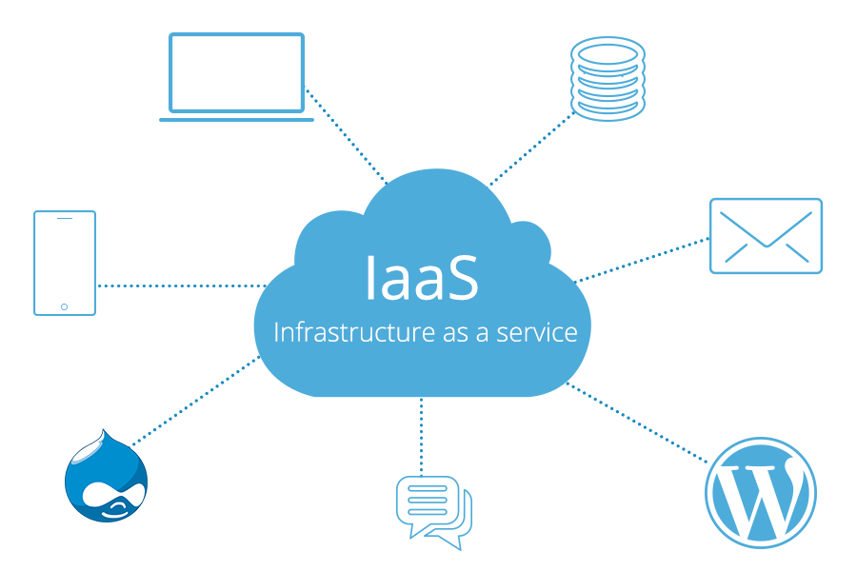
Infrastructure as a Service (IaaS)
IaaS provides users with virtualized computing resources over the internet. Users have access to virtual machines, storage, networks, and other fundamental computing resources, allowing them to build and manage their own infrastructure. Users have control over operating systems, applications, and some networking components. They are responsible for managing and maintaining their applications and data, while the cloud provider manages the underlying infrastructure.

Slide 9
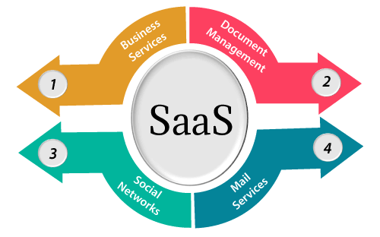
Software as a Service (SaaS)
SaaS delivers fully functional applications over the internet on a subscription basis. Users can access and use software applications hosted by the cloud provider without the need for installation or maintenance. The provider handles all aspects of infrastructure, including security, updates, and availability. Users can access the application through a web browser or thin client, and data is stored in the cloud.

Slide 10
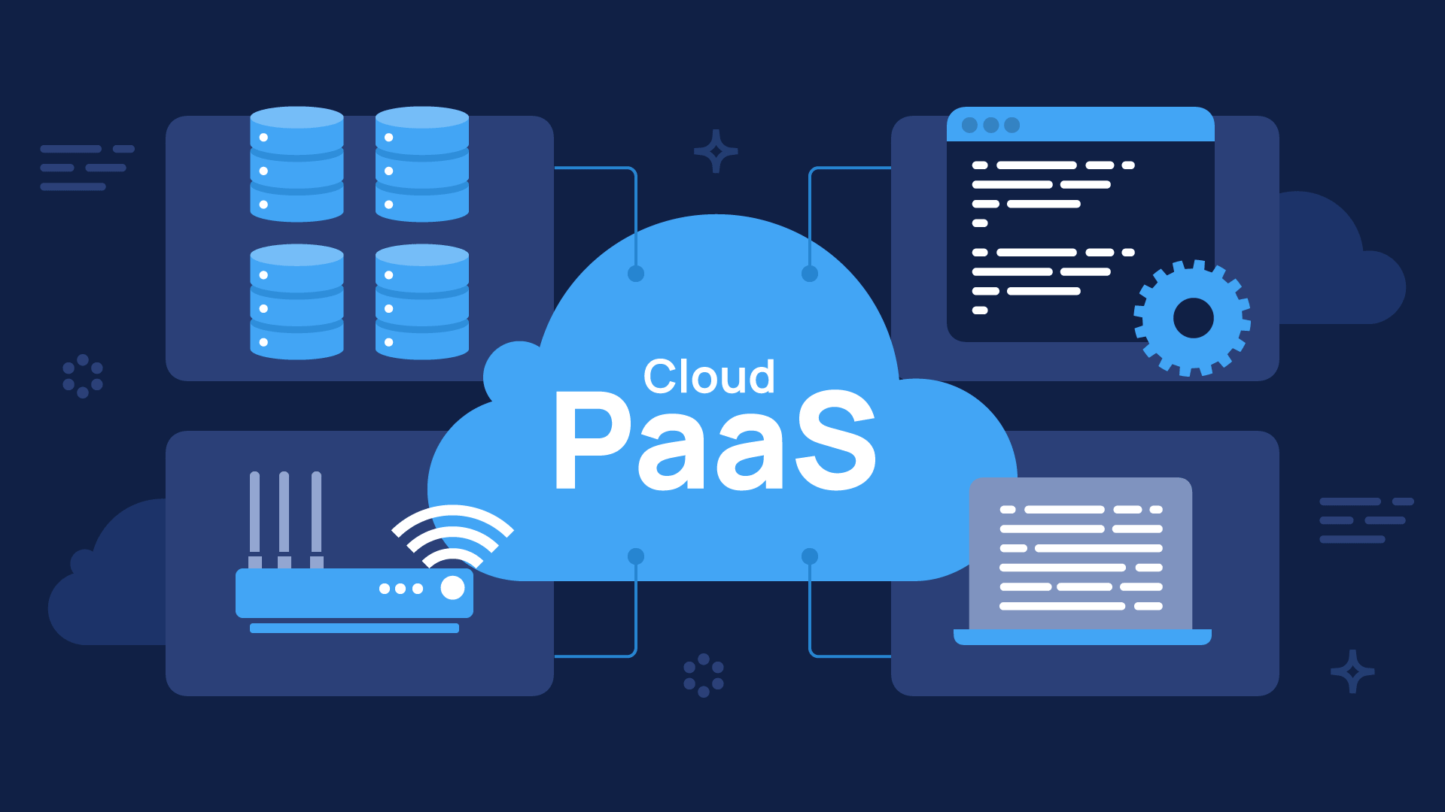
Platform as a Service (PaaS)
PaaS offers a complete development and deployment environment in the cloud. Users can build, test, and deploy applications without the need to manage the underlying infrastructure. PaaS provides a platform with development tools, runtime environments, and deployment management, allowing developers to focus on application development rather than infrastructure concerns. PaaS typically supports scalability, collaboration, and integration with other cloud services.

Slide 11
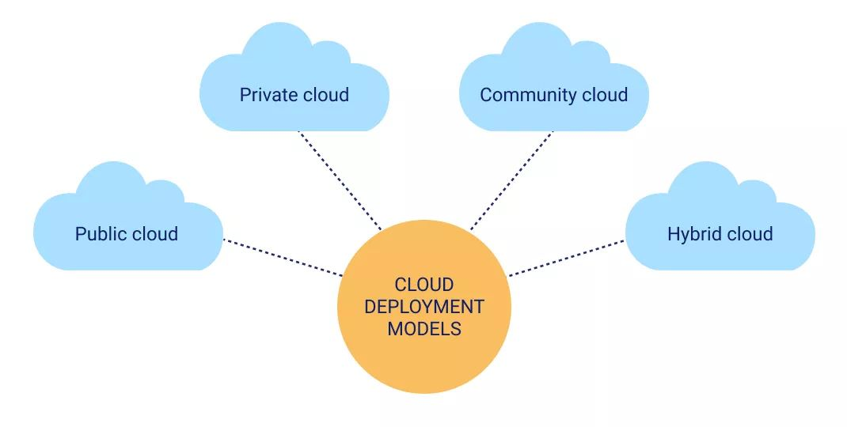
Deployment models
Deployment models in cloud computing refer to the different ways in which cloud services and infrastructure are deployed and accessed. The main deployment models in cloud computing are:
Public Cloud
Private Cloud
Hybrid Cloud
Community Cloud

Slide 12
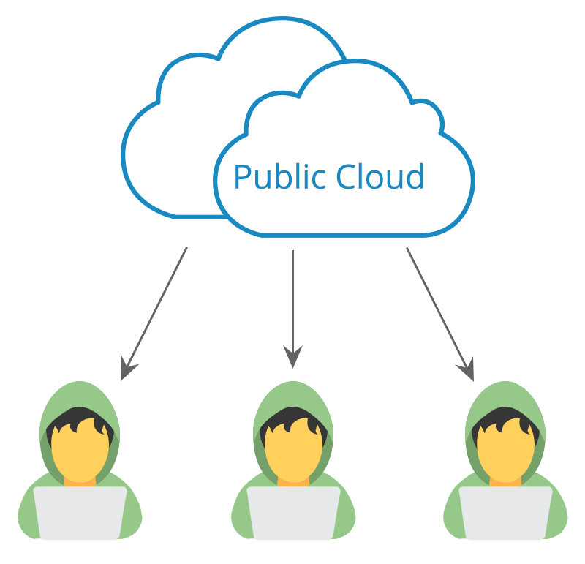
Public Cloud
In the public cloud model, cloud services are provided by third-party vendors over the internet. The infrastructure and resources are shared among multiple organizations and users. Public cloud services are typically cost-effective and scalable, as users pay for the resources they consume. Examples of public cloud providers include Amazon Web Services (AWS), Microsoft Azure, and Google Cloud Platform.

Slide 13
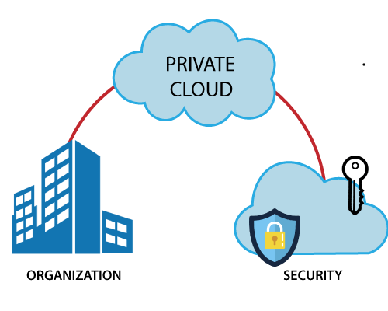
Private Cloud
A private cloud is dedicated to a single organization or entity. It can be physically located on-premises or hosted by a third-party service provider. Private clouds offer increased control, security, and customization options compared to public clouds. They are often used by organizations with strict security and compliance requirements or those handling sensitive data.

Slide 14
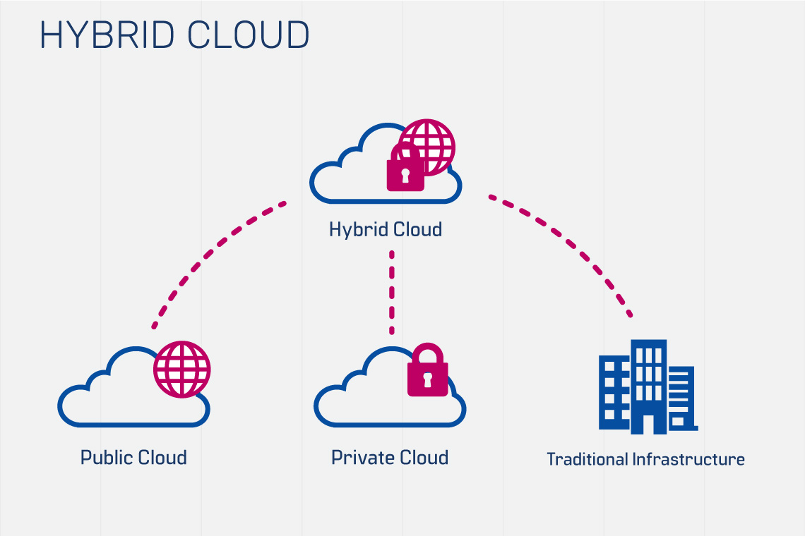
Hybrid Cloud
A hybrid cloud model combines elements of both public and private clouds. It allows organizations to integrate and manage workloads across multiple environments, such as public and private clouds, as well as on-premises infrastructure. This model provides flexibility and enables businesses to optimize resource utilization, scalability, and cost efficiency. Hybrid clouds are useful for organizations with fluctuating workloads or specific data placement requirements.

Slide 15
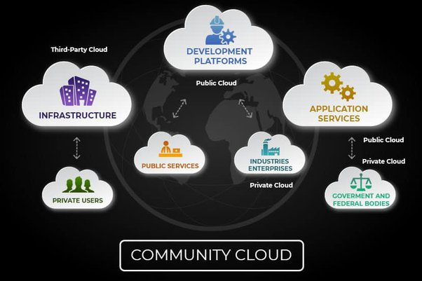
Community Cloud
A community cloud is a shared infrastructure that serves a specific community or industry with shared concerns, such as regulatory compliance. It is designed to meet the unique needs of a particular group, offering collaboration, data sharing, and resource pooling among community members. Community clouds provide cost sharing and enhanced security measures tailored to the community's requirements.

Slide 16
Cloud computing challenges
Security Concerns: Security is a significant challenge in cloud computing. Storing data and applications in the cloud requires trusting the cloud service provider's security measures. Organizations must ensure that proper security controls, such as encryption, access management, and regular security audits, are in place to protect sensitive data from unauthorized access or data breaches.
Data Privacy and Compliance: Organizations may have concerns regarding data privacy and compliance when using cloud services, particularly when dealing with regulated industries or sensitive customer information. It is essential to ensure that the cloud service provider complies with relevant data protection regulations and industry-specific compliance requirements.
Vendor Lock-In: Migrating to the cloud often involves transferring applications, data, and infrastructure to a specific cloud service provider. This can create vendor lock-in, making it challenging to switch to another provider in the future. Organizations should consider interoperability and data portability when selecting a cloud provider to avoid being locked into a specific platform.

Slide 17
Conti….
Downtime and Reliability: Cloud services are dependent on the internet and the availability of the cloud provider's infrastructure. Downtime and service disruptions can occur, impacting business operations and user experience. Organizations should assess the reliability and uptime guarantees offered by cloud providers and have backup and disaster recovery plans in place to mitigate the impact of any service interruptions.
Limited Control and Customization: In a public cloud environment, organizations have limited control over the underlying infrastructure and may face limitations in terms of customization options. This can impact specific application requirements or the ability to tailor the infrastructure to unique business needs. Private or hybrid cloud models can provide more control and customization options but come with increased complexity and management responsibilities.
Network Connectivity and Performance: Cloud computing heavily relies on network connectivity. Organizations must ensure reliable and high-bandwidth internet connections to access cloud services efficiently. Network latency and bandwidth limitations can affect the performance of applications and data transfers between the cloud and on-premises infrastructure.

Slide 18
Cloud computing providers
Amazon Web Services (AWS): AWS is one of the largest and most comprehensive cloud computing platforms, offering a wide array of services, including compute, storage, databases, networking, analytics, machine learning, and more. AWS provides a scalable and reliable infrastructure that powers numerous businesses globally.
Microsoft Azure: Microsoft Azure is a cloud computing platform offered by Microsoft. It provides a comprehensive suite of services for building, deploying, and managing applications and services. Azure offers services such as virtual machines, storage, databases, AI, analytics, and IoT solutions. It integrates well with other Microsoft tools and services.
Google Cloud Platform (GCP): Google Cloud Platform is a suite of cloud computing services provided by Google. It offers a range of services, including compute, storage, databases, machine learning, networking, and more. GCP provides a reliable and scalable infrastructure, and it leverages Google's expertise in data analytics and machine learning.
IBM Cloud: IBM Cloud provides a broad range of cloud services, including infrastructure, platform, and software services. It offers capabilities for computing, storage, networking, AI, blockchain, and more. IBM Cloud focuses on enterprise-grade solutions and provides integration with other IBM services and solutions.
Oracle Cloud: Oracle Cloud offers a comprehensive set of cloud services, including infrastructure, platform, and software services. It provides solutions for computing, storage, databases, AI, analytics, and more. Oracle Cloud focuses on delivering enterprise-grade capabilities and integrates well with Oracle's database and application offerings.

Slide 19
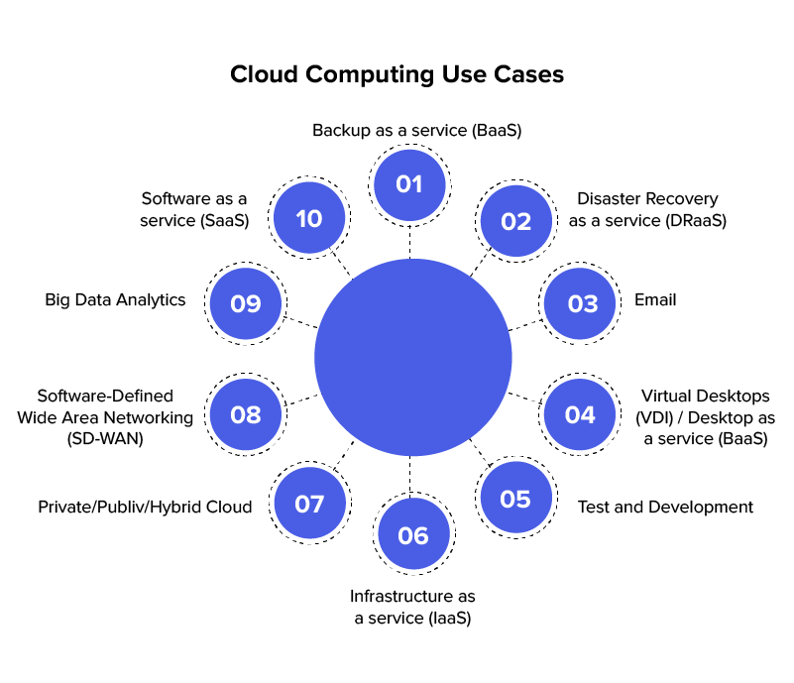
Cloud computing use cases
Infrastructure Scaling and Agility: Cloud computing allows organizations to scale their infrastructure up or down based on demand. It is particularly beneficial for businesses with fluctuating workloads or those experiencing rapid growth. By leveraging the cloud, organizations can quickly provision and deprovision computing resources to match their needs, ensuring optimal resource utilization and cost efficiency.
Data Storage and Backup: Cloud storage services offer a cost-effective and scalable solution for storing and backing up data. Organizations can securely store large amounts of data in the cloud without the need for extensive on-premises infrastructure. Cloud storage also provides data redundancy and disaster recovery capabilities, ensuring data availability and business continuity.
Application Development and Testing: Cloud platforms provide developers with the necessary infrastructure and tools to build, test, and deploy applications. Development teams can leverage the scalability, automation, and collaboration features of cloud platforms to accelerate the development lifecycle, reduce time to market, and improve collaboration among team members.

Slide 20
Conti….
Big Data Analytics: Cloud computing offers powerful capabilities for processing and analyzing large volumes of data. Organizations can leverage cloud-based analytics platforms to derive valuable insights, perform complex data analysis, and make data-driven decisions. The elastic nature of the cloud allows businesses to scale their analytics workloads based on data processing requirements.
Software as a Service (SaaS) Applications: SaaS applications are delivered over the internet and hosted in the cloud. They provide users with ready-to-use software without the need for installation or maintenance. SaaS solutions encompass a wide range of applications, such as customer relationship management (CRM), human resources management, collaboration tools, and more.
Internet of Things (IoT): Cloud computing is instrumental in enabling the connectivity and management of IoT devices. Cloud platforms can process and analyze data from numerous IoT devices, providing real-time insights, automation, and remote control. Cloud-based IoT solutions are used in industries such as manufacturing, transportation, healthcare, and smart cities.
Disaster Recovery and Business Continuity: Cloud computing provides robust disaster recovery capabilities. Organizations can replicate their infrastructure and data to the cloud, ensuring business continuity in the event of a disaster or system failure. Cloud-based disaster recovery solutions offer rapid data recovery, minimal downtime, and cost savings compared to traditional disaster recovery approaches.

Slide 21
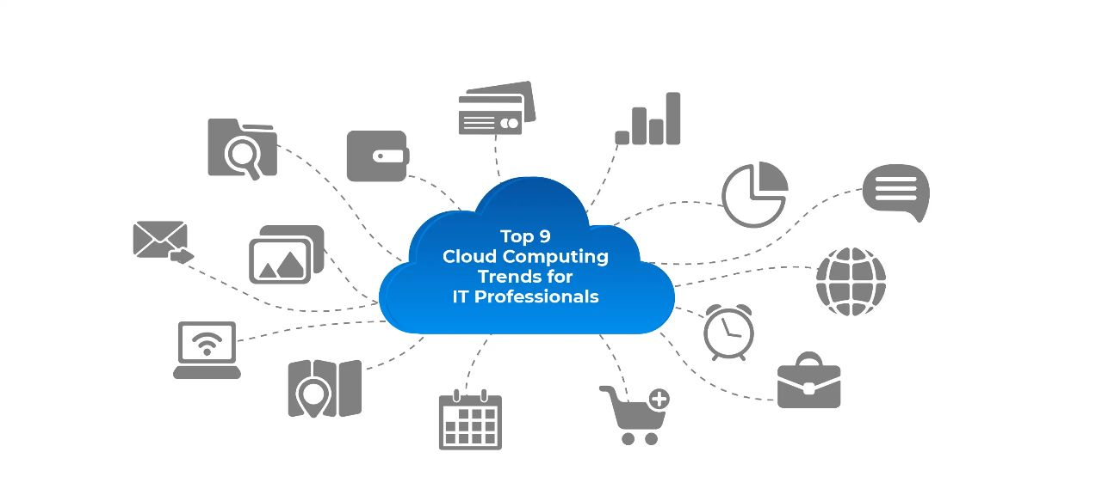
Cloud computing trends
Multi-Cloud and Hybrid Cloud Adoption: Organizations are increasingly adopting multi-cloud and hybrid cloud strategies. Multi-cloud refers to the use of multiple cloud providers to leverage the strengths and capabilities of different platforms. Hybrid cloud combines private and public cloud environments, allowing organizations to balance control, security, and scalability. These approaches enable flexibility, mitigate vendor lock-in, and optimize resource utilization.
Edge Computing: Edge computing is gaining prominence as organizations seek to process and analyze data closer to the source. By placing computing resources at the edge of the network, near IoT devices or end-users, organizations can reduce latency, improve real-time decision-making, and manage bandwidth efficiently. Edge computing complements cloud computing, enabling a distributed architecture for processing and storing data.
Serverless Computing: Serverless computing, also known as Function as a Service (FaaS), is growing in popularity. It allows developers to focus solely on writing and deploying code without worrying about underlying infrastructure management. With serverless computing, developers can execute functions in response to events, paying only for the actual function execution time. It offers scalability, cost-efficiency, and reduces the need for infrastructure provisioning and management.
Artificial Intelligence and Machine Learning in the Cloud: Cloud computing provides a scalable and accessible platform for organizations to leverage artificial intelligence (AI) and machine learning (ML) capabilities. Cloud providers offer AI/ML services, such as pre-trained models, automated machine learning, and data analytics tools. These services enable organizations to derive insights, build intelligent applications, and enhance decision-making using AI and ML algorithms.

Slide 22
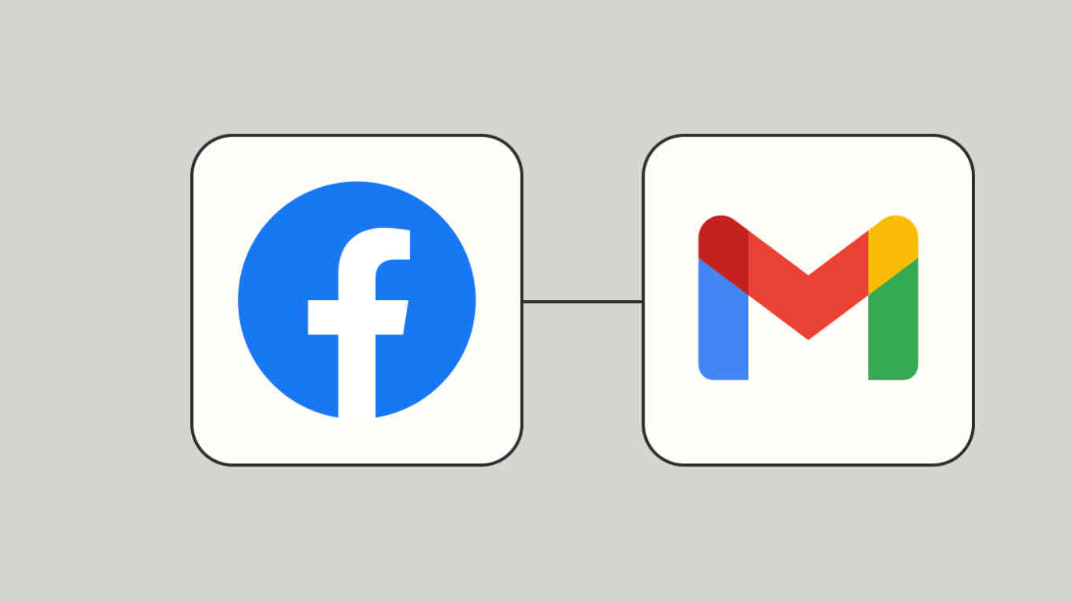
Examples of cloud computing
Dropbox, Gmail, Facebook
The number of online cloud storage providers is increasing every day, and each is competing on the amount of storage that can be provided to the customer.
Right now, Dropbox is the clear leader in streamlined cloud storage, allowing users to access files through their application or website on any device with up to 1 terabyte of free storage.
Gmail, Google's email service provider, on the other hand, offers unlimited storage on the cloud. Gmail has revolutionized the way we send email and is largely responsible for the increasing use of email across the world.
Facebook is a mixture of both in that it can store an infinite amount of information, pictures and videos on your profile. Then they can be easily accessed on multiple devices. Facebook goes a step further with its Messenger app, which allows profiles to exchange data.

Slide 23
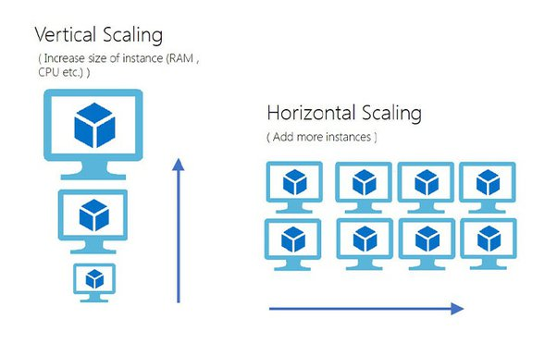
Scaling in Cloud Computing
Cloud scalability in cloud computing refers to increasing or decreasing IT resources as needed to meet changing demand. Scalability is one of the hallmarks of the cloud and the primary driver of its explosive popularity with businesses. Some types of scaling are:
Vertical Scalability (Scaled-up)
horizontal scalability
diagonal scalability

Slide 24
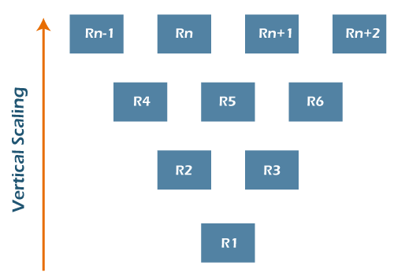
VERTICAL SCALING
To understand vertical scaling, imagine a 20-story hotel. There are innumerable rooms inside this hotel from where the guests keep coming and going. Often there are spaces available, as not all rooms are filled at once. People can move easily as there is space for them. As long as the capacity of this hotel is not exceeded, no problem. This is vertical scaling.
With computing, you can add or subtract resources, including memory or storage, within the server, as long as the resources do not exceed the capacity of the machine. Although it has its limitations, it is a way to improve your server and avoid latency and extra management. Like in the hotel example, resources can come and go easily and quickly, as long as there is room for them.

Slide 25
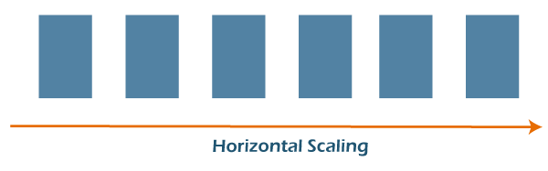
VERTICAL SCALING
Horizontal scaling is a bit different. This time, imagine a two-lane highway. Cars travel smoothly in each direction without major traffic problems. But then the area around the highway develops - new buildings are built, and traffic increases. Very soon, this two-lane highway is filled with cars, and accidents become common. Two lanes are no longer enough. To avoid these issues, more lanes are added, and an overpass is constructed. Although it takes a long time, it solves the problem.
Horizontal scaling refers to adding more servers to your network, rather than simply adding resources like with vertical scaling. This method tends to take more time and is more complex, but it allows you to connect servers together, handle traffic efficiently and execute concurrent workloads.

Slide 26

conclusion
In conclusion, cloud computing has revolutionized the way businesses and individuals access and utilize technology. It offers cost-efficiency, scalability, accessibility, and promotes collaboration. With its flexible deployment models and a wide range of services, cloud computing empowers organizations to innovate, accelerate time-to-market, and focus on their core competencies. While security and privacy concerns exist, proper planning and adherence to best practices can mitigate these challenges. Cloud computing continues to evolve, driving digital transformation and enabling businesses to thrive in today's dynamic and interconnected world.

